Slide 1

Multi-Omics Analysis of Tumor-Infiltrating T Cells Across Cancer Types
This presentation explores the single-cell transcriptomic analysis of tumor-infiltrating T cells in pancreatic (PACA) and esophageal (ESCA) cancers using the GSE156728 dataset. Our goal is to identify T cell subtypes, assess their gene expression patterns, and determine subtype-specific markers such as FOXP3, IL2RA, and TNFRSF4. This study provides crucial insights into the heterogeneity of tumor-infiltrating T cells and their potential roles in cancer immunotherapy.

Slide 2

Data Processing and Quality Control
Data Acquisition
Downloaded CD4+ and CD8+ T cell expression matrices for PACA and ESCA cancers
Seurat Object Creation
Created and merged Seurat objects for each sample
Quality Control
Filtered low-quality cells based on gene counts and mitochondrial gene percentage
Our rigorous data processing approach resulted in a merged object containing over 34,000 high-quality cells, ensuring a robust foundation for subsequent analyses.

Slide 3

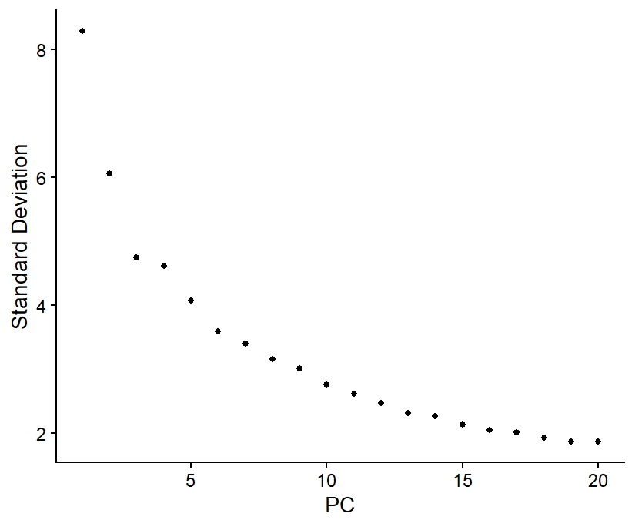




Dimensionality Reduction and Clustering
Principal Component Analysis (PCA)
Identified main axes of variation in the data
Elbow Plot Analysis
Guided selection of top 10 PCs for further analysis
UMAP Dimensionality Reduction
Visualized high-dimensional data in 2D space
Louvain Clustering
Identified 13 distinct T cell clusters
This multi-step approach allowed us to effectively reduce data complexity while preserving important biological signals, resulting in the identification of 13 distinct T cell clusters.

Slide 4

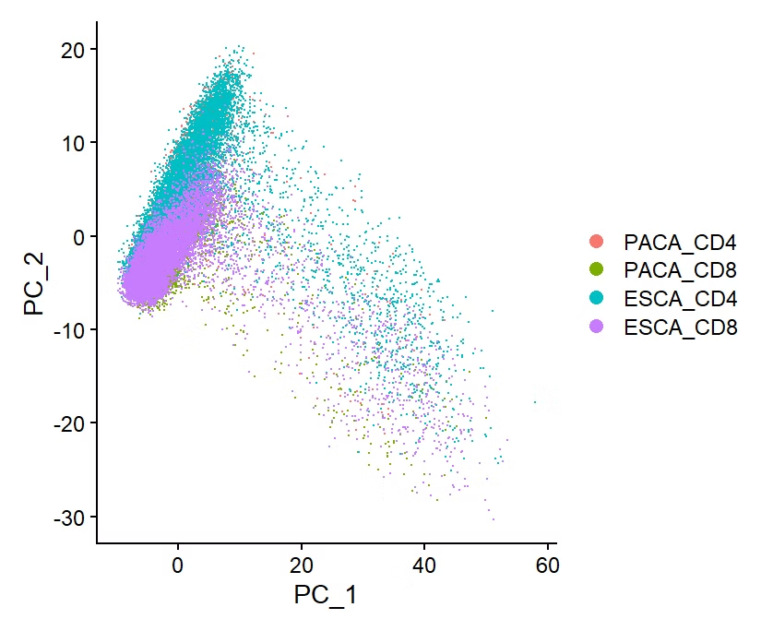
UMAP Visualization of T Cell Clusters
13 Distinct Clusters
Spatial Relationships
UMAP plot reveals clear separation between T cell subtypes
Proximity of clusters suggests potential functional similarities
Cluster Sizes
Varying cluster sizes indicate different abundances of T cell subtypes
The UMAP visualization provides a powerful tool for understanding the complex landscape of tumor-infiltrating T cells, highlighting the heterogeneity present in the tumor microenvironment.

Slide 5

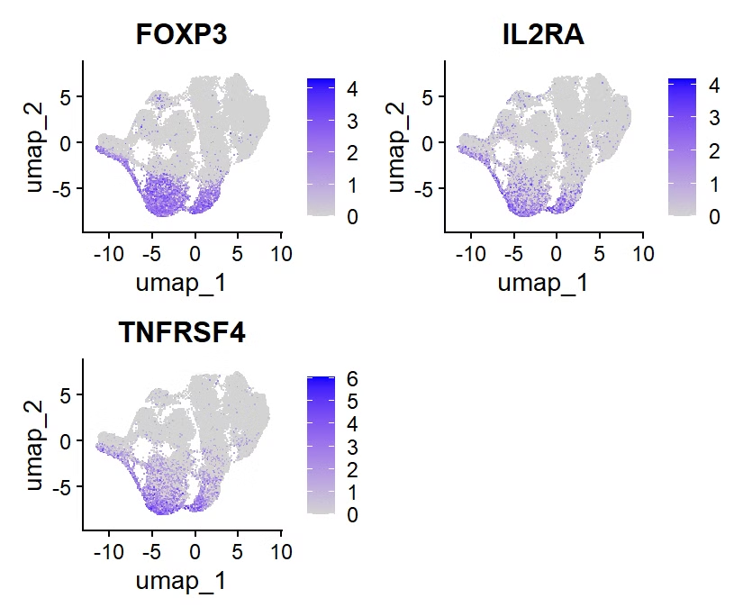
Marker Gene Identification
Differential Expression Analysis
Treg Marker Expression
Potential Immunosuppressive Role
Cluster 0 showed strong expression of FOXP3, IL2RA, and TNFRSF4, indicating the presence of regulatory T cells
Performed across all identified clusters to uncover unique gene signatures
The identified Treg population may play a crucial role in modulating the tumor microenvironment
The identification of a distinct cluster expressing known Treg markers provides valuable insights into the composition of tumor-infiltrating T cells and their potential functional roles in cancer progression.

Slide 6

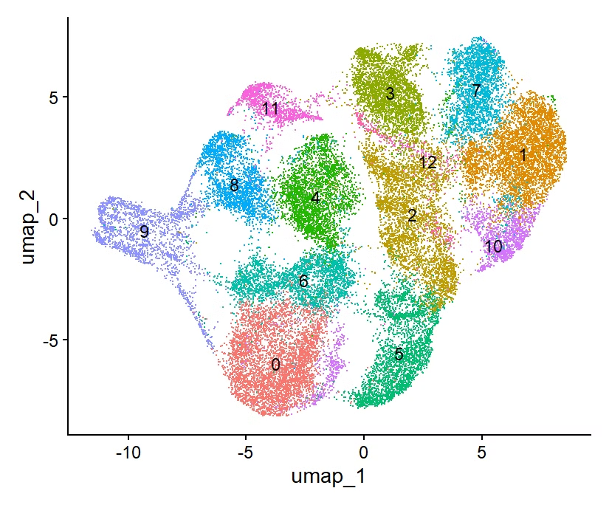




PCA Visualization
Cancer Type Separation
T Cell Subtype Distribution
PCA reveals distinct clustering patterns between PACA and ESCA samples
CD4+ and CD8+ T cells show unique distribution patterns across the PCA space
1
2
Biological Interpretation
Variance Explanation
4
3
PCA results guide further exploration of key genes and pathways driving T cell heterogeneity
Top principal components capture the most significant sources of variation in the dataset
The PCA visualization provides a comprehensive overview of the dataset, highlighting key differences between cancer types and T cell subtypes that inform subsequent analyses.

Slide 7

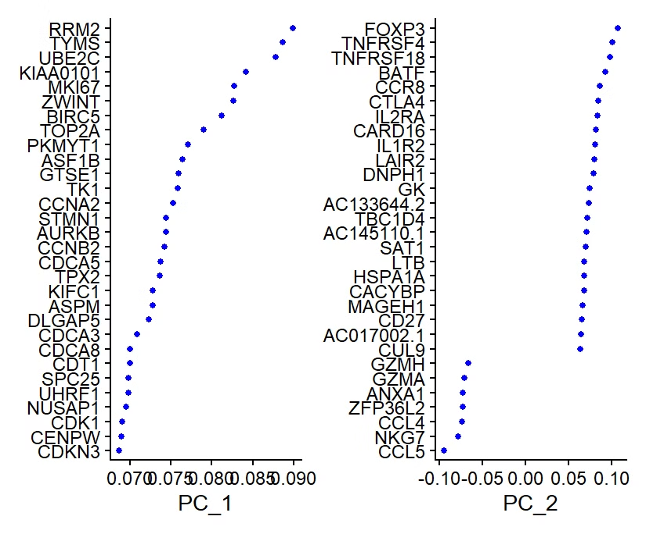
PCA Loading Genes and Elbow Plot
Top PCA Loading Genes
Elbow Plot Analysis
Heatmap reveals genes contributing most to PC1 and PC2, providing insights into key biological processes driving variation
Standard deviation across principal components guided the selection of top 10 PCs for downstream analysis
The combination of top PCA loading genes and the elbow plot analysis provides a robust framework for dimensionality reduction, ensuring that we capture the most relevant biological signals while minimizing noise in our dataset.

Slide 8

Conclusion and Future Directions
T Cell Heterogeneity
Treg Population
Identified 13 distinct clusters of tumor-infiltrating T cells in PACA and ESCA cancers
Discovered a FOXP3+ IL2RA+ TNFRSF4+ cluster, suggesting the presence of immunosuppressive Tregs
Immunotherapy Implications
Findings may inform future targeted immunotherapy strategies for PACA and ESCA cancers
This study provides valuable insights into the complex landscape of tumor-infiltrating T cells. The identification of a potentially immunosuppressive Treg population opens new avenues for targeted cancer therapies. Future research should focus on validating these findings and exploring their clinical implications.

